Slide 1

Learn. Imagine. Build. .NET Conf
.NET Conf Keynote: .NET Everywhere!
Scott Hunter, Director PM .NET, @coolcsh
Miguel de Icaza, Distinguished Engineer Mobile, @migueldeicaza
Mads Torgersen, C# Language Designer, @madstorgersen

Slide 2
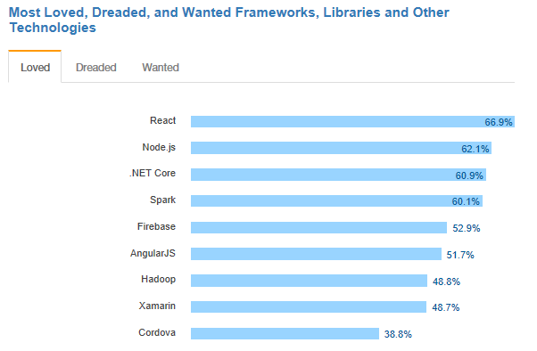
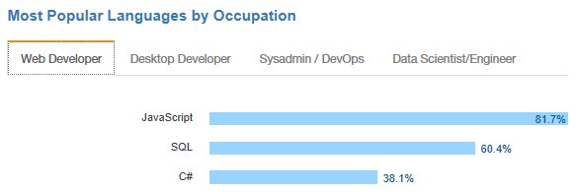
.NET is active and growing
.NET Core debuts at #3 most loved Framework on Stack Overflow Technology Survey 2017
C# is #3 most popular language for desktop and web developers on Stack Overflow Technology Survey 2017
Source: http://stackoverflow.com/insights/survey/2017

Slide 3
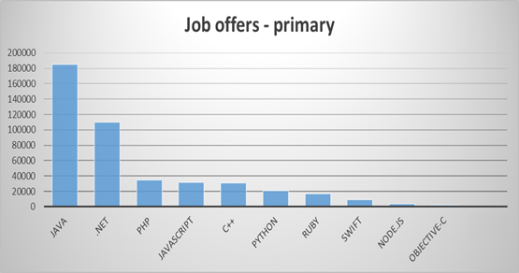
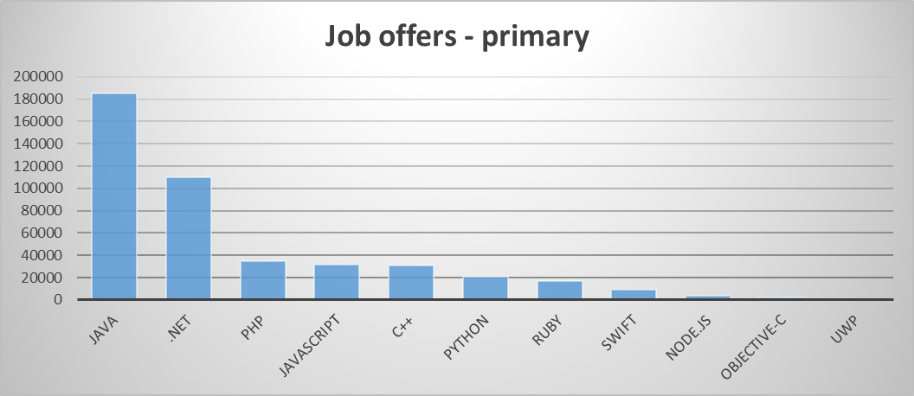
Community Momentum
Job market
Modern Relevance
.NET OSS
#2 demanded primary technology
(LinkedIn)
Most popular Microsoft technology in Hacker News and Reddit

Slide 4






Thank you to all our contributors!
Community PRs by month
“Samsung is embracing .NET because it is a completely open source project.” — Samsung
"ASP.NET is open source, that allows us to contribute back to it if we have any performance issues which Microsoft review and together we make a better product.“
— Illyriad Games

Slide 5

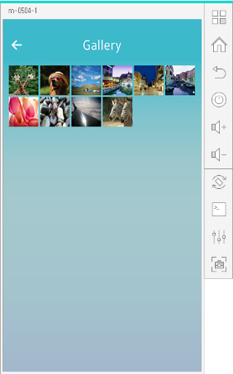
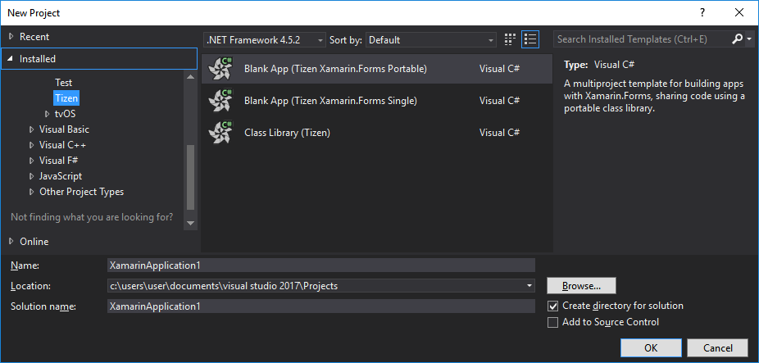
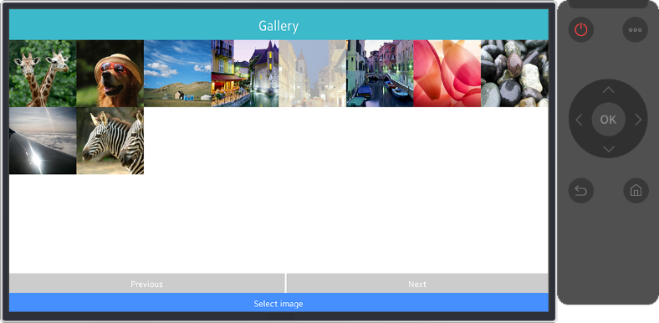
.NET Core Support on Tizen, Samsung Devices
Build Tizen apps for mobiles, wearables and TVs with .NET Core and Xamarin.Forms
Preview #1
Preview #2
Preview #3
Preview #4
Official Release
Mobile
Nov 2016
Mobile/TV
Jan 2017
Mobile/TV
Mar 2017
Mobile/TV
June 2017
Mobile/TV/Wearable
October 2017
Visual Studio Tools for Tizen
Supports everything you need to
develop Tizen apps with .NET core
https://developer.tizen.org/development/tizen-.net-preview/

Slide 6




.NET – A unified platform
TRADITIONAL WINDOWS
WINDOWS 10
WEB APPS, CLOUD SERVICES
MOBILE
IoT
AI
GAMES, VR, AR
TOOLS
.NET STANDARD
VISUAL STUDIO
LIBRARIES
VISUAL STUDIO FOR MAC
VISUAL STUDIO CODE
INFRASTRUCTURE
RUNTIME COMPONENTS
COMPILERS
LANGUAGES
COMMAND LINE INTERFACE

Slide 7
.NET Standard brings it all together
TRADITIONAL WINDOWS
WINDOWS 10
WEB APPS, CLOUD SERVICES
MOBILE
IoT
AI
GAMES, VR, AR
.NET Standard allows sharing code, binaries and skills between .NET client, server and all of its flavors.
.NET Standard provides a specification for any platform to implement (conceptually similar to HTML)
All .NET runtimes provided by Microsoft are implementing the standard
.NET STANDARD
LIBRARIES
INFRASTRUCTURE
RUNTIME COMPONENTS
COMPILERS
LANGUAGES

Slide 8
.NET Standard 2.0
Has much bigger API surface
Extended to cover intersection between .NET Framework and Xamarin
Also makes .NET Core 2.0 bigger as it implements .NET Standard 2.0
+20K
More APIs than
.NET Standard 1.x
Can reference .NET Framework libraries
Compatibility shim allows referencing existing .NET Framework binaries
No recompile required – also covers existing NuGet packages
Limited to libraries that only use APIs that are available for .NET Standard
~70%
of NuGet packages
are API compatible

Slide 9
APIs in .NET Standard 2.0
DATA
DataSet • DataTable • SQLClient
XML
XLinq • XML Document • XPath • Schema • XSL
SERIALIZATION
BinaryFormatter • Data Contract • XML
NETWORKING
Sockets • HTTP • Mail • WebSockets
IO
Files • Compression • MMF
THREADING
Threads • Thread Pool • Tasks
CORE
Primitives • Collections • Reflection • Interop • Linq
Notes:
https://docs.microsoft.com/en-us/dotnet/standard/net-standard
Data - DataSet * DataTable * SQLClient

Slide 10
Demo .NET Standard 2.0
Scott Hunter

Slide 11

.NET Core CLI
Supports multiple SDK’s
All the templates in Visual Studio included
C#, F# and VB
New commands for Solutions, Project to Project, …
Notes:
Hunter will put stuff here.

Slide 12
Demo .NET Core CLI
Scott Hunter

Slide 13
.NET Core 2.0
More APIs
More project templates
More distros
Simplified packaging
New and improved tooling in Visual Studio 2017
Visual Studio for Mac support
Notes:
Performance – From profile guided optimizations to faster JIT compiler to the numerous performance improvement made by the community in the .NET Core libraries, .NET Core 2.0 is the fastest version of .NET ever.
Expanded Libraries - .NET Core 2.0 implements the .NET Standard 2.0 which has expanded the API surface area so that code and binaries can be shared across runtimes and workloads.

Slide 14
ASP.NET Core 2.0
Faster (20% faster in Tech Empower benchmark)
Razor Pages
Razor support for C# 7.1
Smaller Publish (2.6MB vs 16.8 MB)
Azure Diagnostics & Live Analytics
Angular and React templates
Authenticator App support in templates

Slide 15
Demo ASP.NET Core 2.0
Scott Hunter

Slide 16
Announcing:
Windows Compatibility Pack for .NET Core
Notes:
GO GET IT!

Slide 17
Windows Compatibility Pack for .NET Core
Microsoft.Win32.Registry
System.CodeDom
System.Configuration.ConfigurationManager
System.Drawing
System.Runtime.Caching
And many more…
PREVIEW AVAILABLE SOON

Slide 18
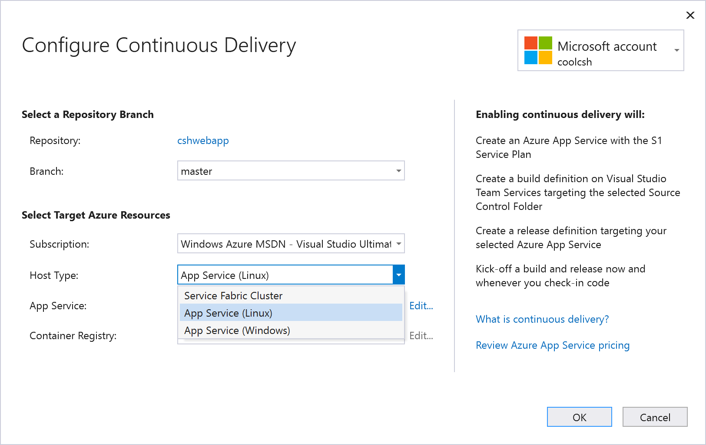
Visual Studio 2017 and Azure
Azure Functions
CI/CD support for containers & App Service
Azure Diagnostics
Notes:
Visual Studio 2017 now supports creating and running .NET Core 2.0 apps, just remember the SDK does not yet come as part of Visual Studio 2017, so you will need to download and install the .NET Core 2.0 SDK separately.
With the added support for .NET Core 2.0 in Visual Studio 2017 you can create .NET Core web and console applications, and .NET Core and .NET Standard class libraries using Visual Basic as well as C#
NET Framework and .NET Standard/Core interop: Users can now more seamlessly install or refer to .NET Core/.NET Standard libraries from .NET Framework projects and vice versa. No need to manually add interop NuGet packages – system does this for you automatically.
Build: Incremental builds for .NET Core is now turned ON by default.
LUT
maintain quality and test coverage of your .NET Core apps and libraries during rapid development. See the results of your unit tests as you code to
Automatically execute impacted tests as you edit code and get real-time visual feedback on the test results. Ensure that your changes do not break the tests, simply by changing your code!
Live Unit Testing updates each line of code in the Visual Studio editor to show you whether the code you're writing is covered by unit tests and whether the tests that cover it are passing. See where you are missing tests to quickly decide which tests to create next.
AZURE FUNCTIONS
Visual Studio Tools for Azure Functions are now included as part of the Visual Studio installation. To get the tools, you need to make sure to install the Azure workload.
Create pre-compiled C# functions that provide better cold start performance than script based functions, and opens the entire eco-system of Visual Studio tools for class libraries including code analysis, unit testing, complete IntelliSense, 3rd party extensions, etc
Use WebJobs attributes to declare function bindings directly in the C# code rather than the separate function.json file

Slide 19
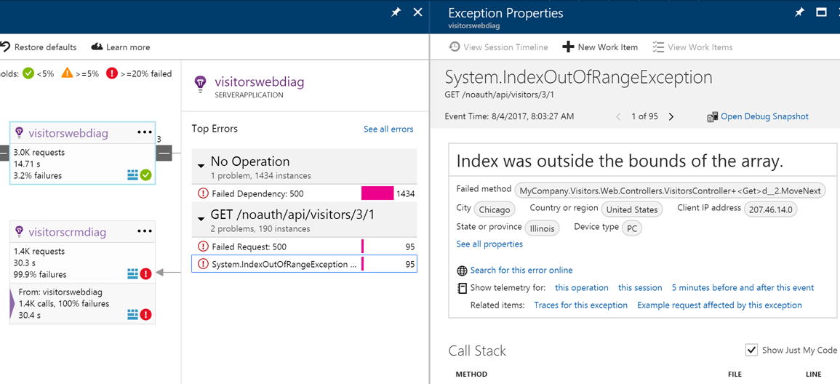
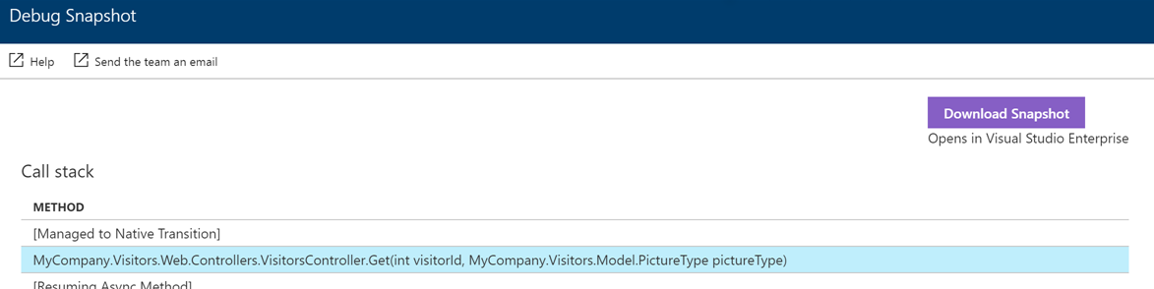
Cloud and Container diagnostics
Simple
No modifications to your app
No republishing of your app
From the Azure Portal
Enable/Disable analytics and diagnostics
See common crashes and performance problems including seeing code
From Visual Studio
See analytics data from portal in real time
Use “snap points” to debug a running application

Slide 20

.NET architecture guides
Available now at: https://dot.net/architecture
eBooks & samples: Web, Containers, mobile
Patterns: Health checks, queueing
More books and patterns coming…

Slide 21
Demo Azure Diagnostics CI/CD
Scott Hunter

Slide 22
Mobile .NET
Miguel de Icaza

Slide 23
Google and Apple
Mobile Operating System Update Season
Oreo
Multi-display, text sizing, PiP,
Fresh Apple Support
iOS 11, tvOS 11, watchOS 4
CoreML rolling out – SeeingAI using it now
ARKit
Vision

Slide 24
UrhoSharp – Easy 3D, VR and AR
Think “Xamarin.Forms for 3D”

Slide 25
AR for Android, iOS and HoloLens

Slide 26
Visual Studio for Mac
.NET Centric
Focused on .NET Developers
Languages
C# 7.1
F# 4.1
Azure
Connected Services
Easy Deployment
Backends for your mobile apps
.NET Core 2.0
Console
ASP.NET Core Web Apps
ASP.NET Core Web API
Unity
Develop and Debug Unity Game Code
Xamarin
Mobile: Android, iOS, watchOS
macOS, tvOS

Slide 27
Demo Visual Studio for Mac
Miguel de Icaza

Slide 28
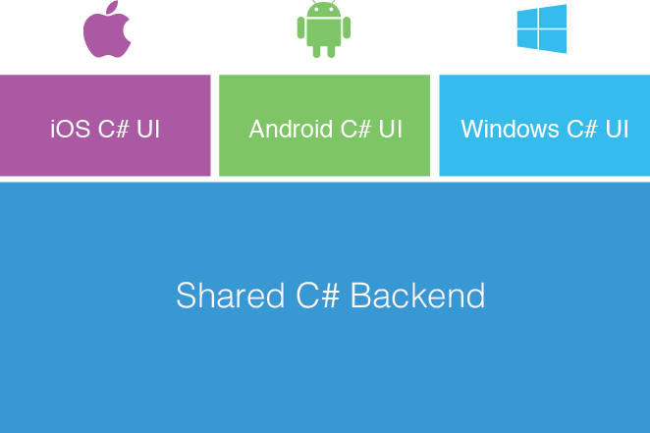
Xamarin + Xamarin.Forms
Shared UI Code
Traditional Xamarin Approach
With Xamarin.Forms

Slide 29
Forms
This Fall
Quality, polish
Performance: Fast Renderers on Android and Layout Compression
Left-to-Right, Right-to-Left
Accessibility
Migration to .NET Standard
The Forms Trilogy
Android
iOS
UWP

Slide 30

The Prequels are Here
Linux
macOS
WPF
Tizen
Unity

Slide 31
Forms Embedding
Add some Forms code to your existing .NET app:
Mac, WPF, UWP, Linux, Android or iOS app
One screen, many screens or your whole app
New
Shared UI Code

Slide 32
.NET Everywhere
There are existing codebases
ObjC, Java, Swift, C++.
How could we bring joy to those communities?

Slide 34




Turns any .NET library into a native library
Android Java
macOS Objective-C
iOS Swift
tvOS Swift
Linux, Mac, Windows C/C++
Jar/Aar
DynamicLib
Framework
Framework
C/C++
Shared C#/.NET Logic

Slide 35
Demo
Miguel de Icaza

Slide 36
Visual Studio and C#
Mads Torgersen

Slide 37
Visual Studio 2017
Performance
Install experience
Navigation and IntelliSense
Refactorings and quick fixes
Code styles
Live Unit Testing (LUT)
C# 7.0

Slide 38
Visual Studio 2017 Update 15.3
Project files are simplified and portable
Navigation and IntelliSense
Live Unit Testing support with .NET Core
More live diagnostics (API design, security, …)
Even more refactorings and quick fixes

Slide 39
C# 7.1 – First point release
Target-typed default expressions
Async Main
Tuple element name inference

Slide 40
Demo Visual Studio and C#
Mads Torgersen

Slide 41
.NET Core 2.0
&
Visual Studio 2017
Download today!
www.dot.net/core
www.visualstudio.com

Slide 42
What we are thinking about next?
Performance and size improvements
Faster inner loop
Small standalone apps
Native
Tooling and libraries
Global tools (“aka npm install –g”)
Machine learning and artificial intelligence
Platforms
Linux diagnostics
IOT/ARM32

Slide 43
C#: The road ahead
C# 7.2
Safe, efficient low-level code
C# 7.3
Next steps for pattern matching?
C# 8.0
Interfaces with default member implementations
Async streams
Nullable reference types

Slide 44
Demo Nullable reference types
Mads Torgersen

Slide 45
Mono and WebAssembly
Two modes of operation
Development: Mono’s Interpreter
Release: Linked + Statically compiled code
.NET <-> JavaScript interop
Exposes .NET API to Javascript, goal: use embeddinator to surface API
Exposes loose and strongly typed Web APIs to C#
https://github.com/lrz/mono-wasm

Slide 46
C# to JavaScript – Weakly Typed
static void FactorialInElement(int n, string eid)
{
WriteLine("Calculating factorial of {0} into DOM element {1}", n, eid);
int f = Factorial(n);
string expr = $"document.getElementById(\"{eid}\").innerText = \"{f}\";",
Mono.WebAssembly.JavaScriptEval(expr);
}

Slide 47
C# to JavaScript – Strongly typed (WIP)
Setup ()
{
// Get a reference to the HTML DOM document.
HtmlDocument document = HtmlPage.GetDocument();
// Get a reference to the body element.
HtmlElement body = document.GetElementById("docBody");
// Create a <main> type element
HtmlElement mainElement = document.CreateElement("main");
// Append the newly created element to the page DOM
body.AppendChild(mainElement);
}

Slide 48
Useful links
.NET Standard 2
https://blogs.msdn.microsoft.com/dotnet/2017/08/14/announcing-net-standard-2-0/
.NET Portability Analyzer
https://github.com/Microsoft/dotnet-apiport/blob/master/docs/VSExtension/README.md
Azure Debug Snapshots
https://docs.microsoft.com/en-us/azure/application-insights/app-insights-snapshot-debugger#configure-snapshot-collection-for-aspnet-core-20-applications

Slide 49
Useful links
Azure Production Debugging
https://docs.microsoft.com/en-us/visualstudio/debugger/debug-live-azure-applications
Nullable reference types
https://github.com/dotnet/roslyn/blob/features/NullableReferenceTypes/docs/features/NullableReferenceTypes/README.md
https://github.com/dotnet/csharplang/issues/790

Slide 50
Learn. Imagine. Build. .NET Conf
The conference continues live on Channel 9! www.dotnetconf.net
Notes:
Beginning

